Slide 1
CHAPTER 13 QUALITATIVE DATA ANALYSIS

Slide 2
Qualitative Analysis
Qualitative analysis
The non-numerical examination and interpretation of observations
To discover underlying meanings and patterns

Slide 3
What is Qualitative Analysis for?
Discovering Patterns in Qualitative Data
Frequencies
Magnitudes
Structures
Processes
Causes
Consequences

Slide 4
What does Qualitative Analysis Involve?
Cross-case analysis
examination of more than one case; looks for patterns occurring across several observations.
Variable-oriented analysis
describes and/or explains a particular variable.
Case-oriented analysis
aims to understand a particular case or several cases by looking closely at the details of each.

Slide 5
What does Qualitative Analysis Involve?
Constant Comparative Method
observations are compared with one another and with the evolving inductive theory.
Four Stages of Constant Comparative Method (Glaser and Strauss):
Looking for evidence of similar incidents across cases
Notes relationships between concepts/phenomena, integrates details about cases and their properties
Delimiting the theory
Writing theory

Slide 6
What Counts as Qualitative Analysis?
Semiotics
study of signs and the meanings associated with them, “the science of signs.”
What is the meaning of:
…a blue ribbon?
…”say cheese”?
…a cross?
…a ghost emoji 👻👻👻

Slide 7
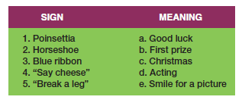
Figure 13-1
Matching Signs and Their Meanings

Slide 8
What Counts as Qualitative Analysis?
Conversation Analysis
meticulous analysis of the details of conversation, based on a complete transcript that includes pauses, breaks, etc.
Fundamental Assumptions
Conversation is socially constructed
Conversations must be understood contextually.
Need excruciatingly accurate transcripts of conversations to understand the structure and meaning of conversation

Slide 9
Qualitative Data Processing
Coding
Classifying or categorizing individual pieces of data, coupled with some kind of retrieval system.
Coding Units

Slide 10
Qualitative Data Processing
Creating Codes
Open Coding
the initial classification and labeling of concepts in qualitative data analysis.
a reanalysis of the results, aimed at identifying the important, general concepts.
Identify the central concept that organizes the other concepts.

Slide 11
Qualitative Data Processing
Memoing
Writing memos that become part of the data for analysis.
Memos can describe and define concepts, deal with methodologies issues, or offer initial theoretical formulations.
Code Notes
Theoretical Notes
Operational Notes

Slide 12
Qualitative Data Processing
Concept Mapping
The graphic display of concepts and their interrelations, useful in the formulation of theory.

Slide 13
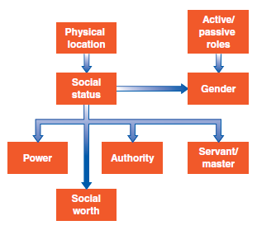
Figure 13-3
An Example of Concept Mapping

Slide 14
Computer Programs for Qualitative Data
QDA Programs:
Atlas.ti 
Dedoose 
MAXQDA 

Slide 15
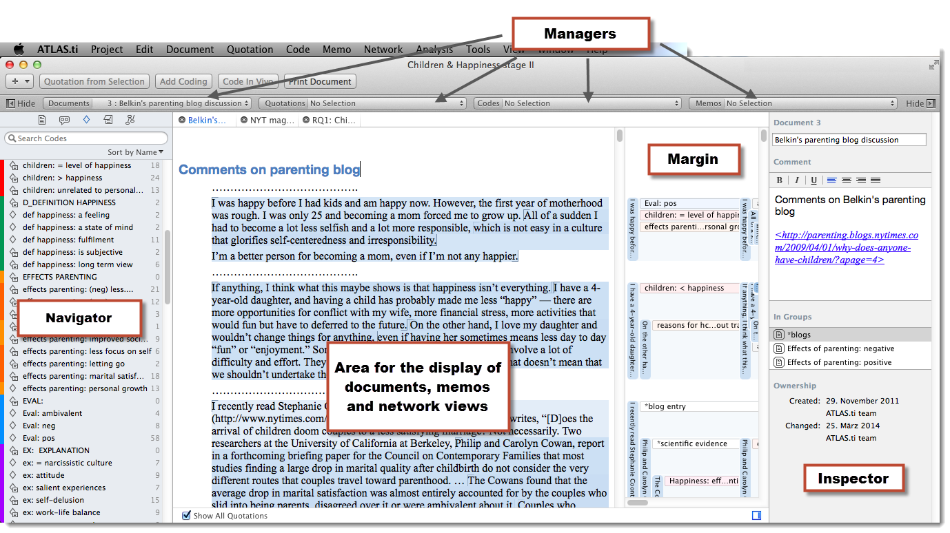
Atlas.ti

Slide 16
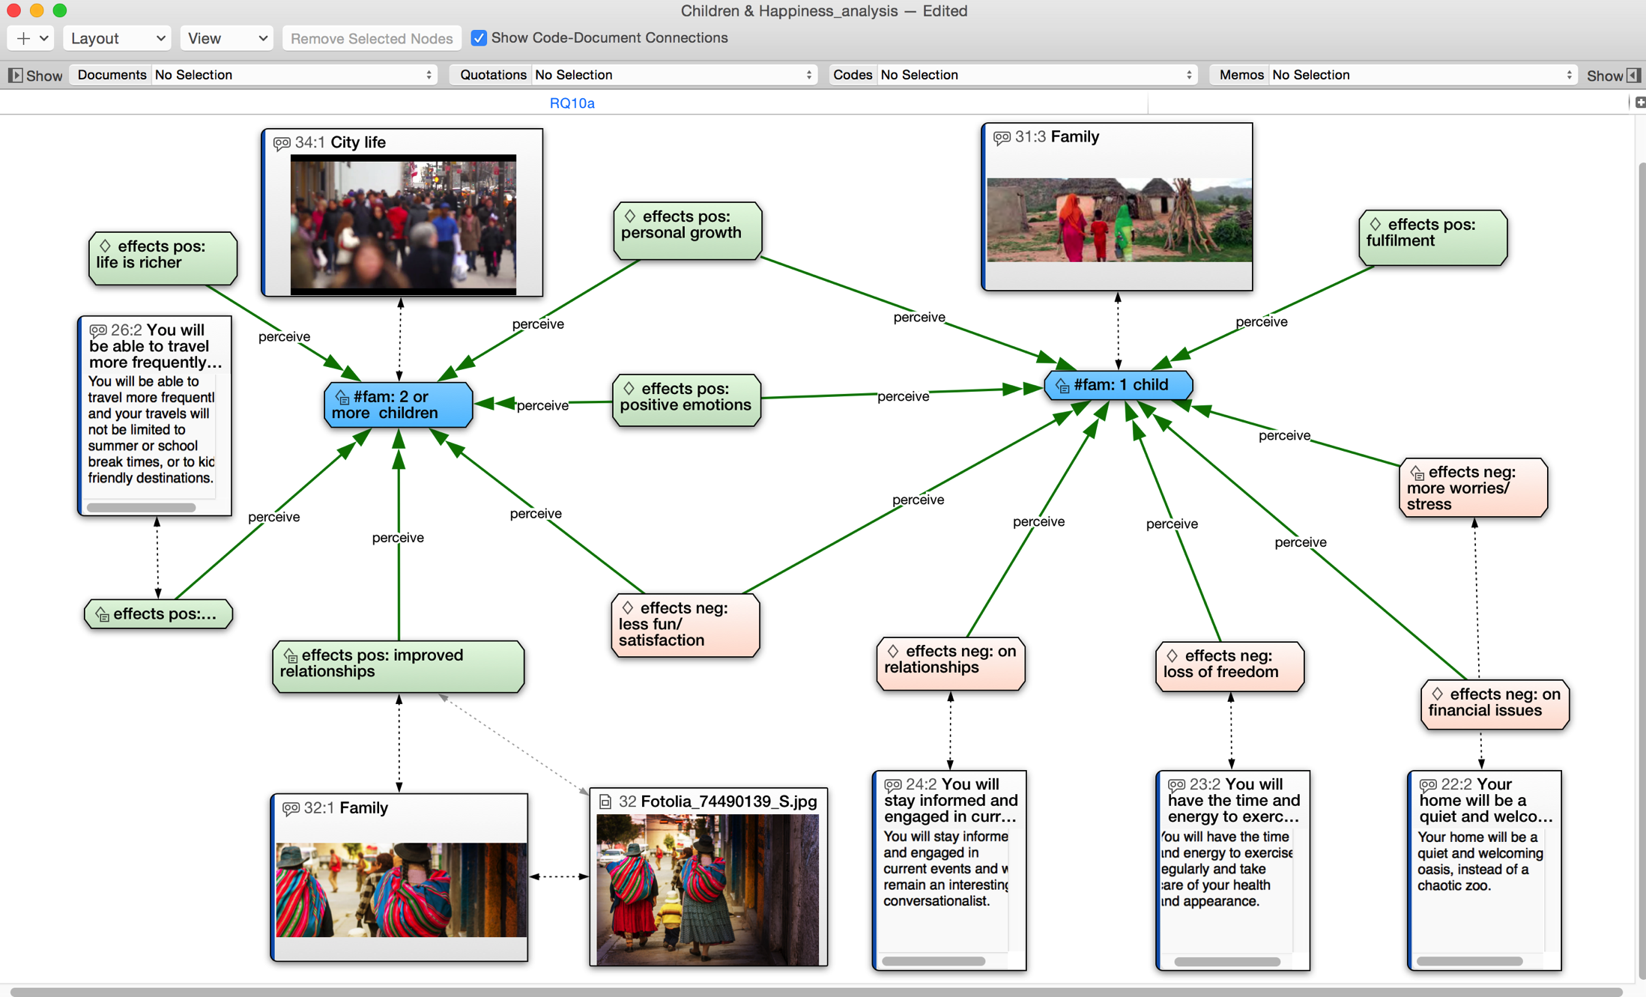
Atlas.ti
An Example of Concept Mapping in Atlas.ti

Slide 17
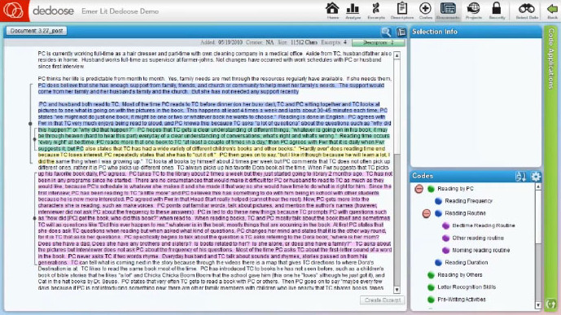
Dedoose

Slide 18
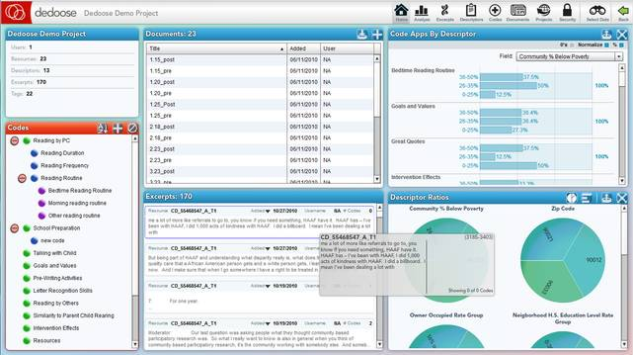
Dedoose

Slide 19
Evaluating the Quality of Qualitative Research
How credible are the findings?
How has knowledge or understanding been extended by the research?
How well does the evaluation address its original aims and purpose?
How well is the scope for drawing wider inferences explained?
How clear is the basis of evaluative appraisal?
How defensible is the research design?
How well defended are the same design/target selection of cases/documents?
How well is the eventual sample composition and coverage described?
How well was the data collection carried out?
How well has the approach to, and formulation of, analysis been conveyed?
How well are the contexts of data sources retained and portrayed?
How well has diversity of perspective and content been explored?
How well has detail, depth, and complexity of the data been conveyed?
How clear are the links between data, interpretation, and conclusions?
How clear and coherent is the reporting?
How clear are the assumptions/theoretical perspectives/values that have shaped the form and output of the evaluation?
What evidence is there of attention to ethical issues?
How adequately has the research process been documented?

